Slide 1

Artificial Intelligence in Healthcare
Course No: ICT 6513
Presented By
Presented To
Joyashish Ghosh
Id No: 2671502
Institute of Information and Communication Technology.
Khulna University of Engineering & Technology.
Dr. M. A. Moyeen
Assistant Professor
Institute of Information and Communication Technology.
Khulna University of Engineering & Technology.
Topics: Byzantine Attack Challenges in Federated Learning for IoMT Healthcare.

Slide 2
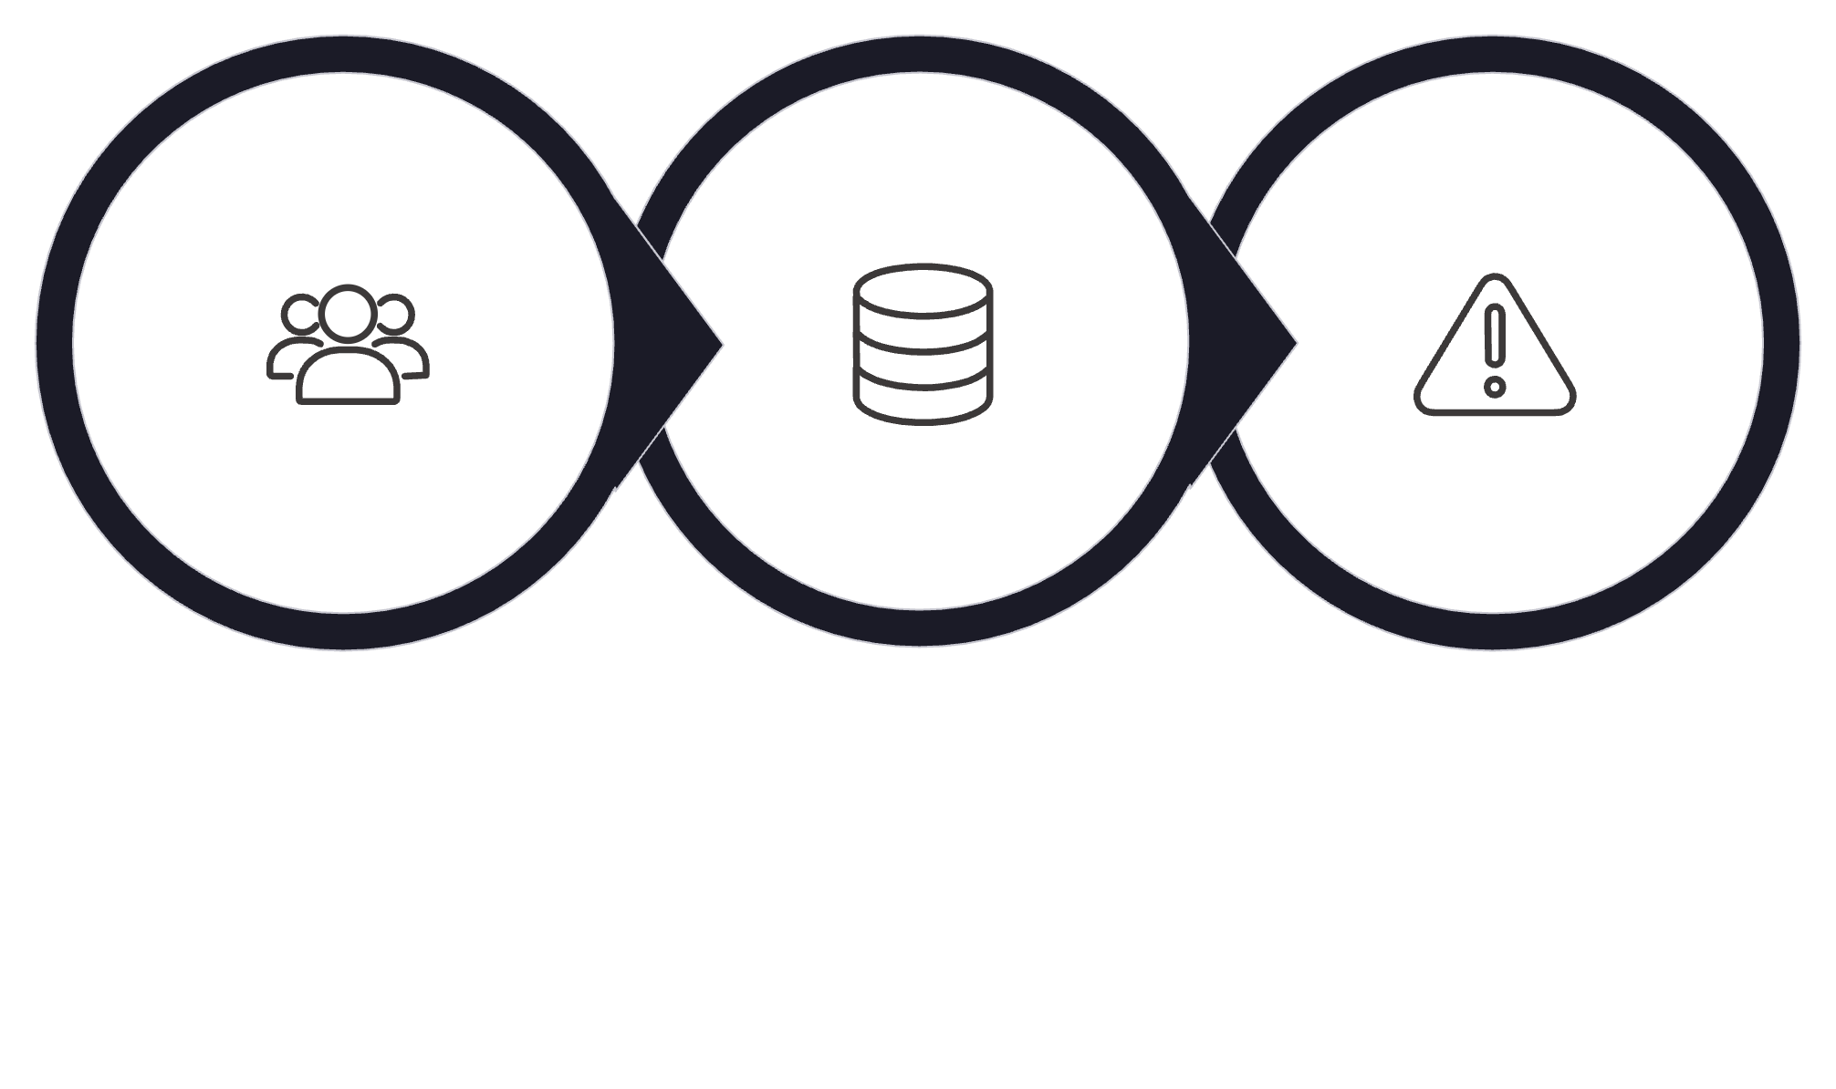
SLIDE 1
Problem Statement
Byzantine Attack Challenges in Federated Learning for IoMT Healthcare
Federated Learning (FL) enables multiple hospitals and IoMT devices to collaboratively train AI models without sharing raw patient data. However, FL is vulnerable to Byzantine attacks, where malicious participants send corrupted or manipulated model updates.
Attack Consequences
Core Imperative
Reduce AI model accuracy
Damage the global model
Produce incorrect disease predictions
Affect clinical decision-making
Developing robust aggregation mechanisms is essential for secure and reliable AI-driven healthcare systems. The integrity of the global model depends on the trustworthiness of every participating client — a single malicious node can compromise the entire network.
Malicious Client
Poisoned Global Model
Compromised Decisions

Slide 3
SLIDE 2
Taxonomy of Byzantine-Robust Federated Learning Solutions
Existing Defense Approaches
Distance-Based Methods
1
Identify malicious updates by measuring similarity between client models.
Krum
Multi-Krum
Statistical-Based Methods
2
Remove abnormal values from model parameters.
Trimmed Mean
Median Aggregation
Hybrid Robust Aggregation
3
Combines multiple defense strategies for stronger protection.
Bulyan
Privacy-Preserving Approaches
4
Protect patient information while maintaining security.
Differential Privacy
Secure Aggregation
5
Adaptive Trust-Based Methods
Evaluate client reliability using historical behavior. Dynamically identify suspicious participants.

Slide 4
SLIDE 3
Security & Privacy Protection
Data Protection in Federated Healthcare AI
Differential Privacy (DP)
Cryptographic Protocols
Adds controlled noise to model updates.
Prevents attackers from extracting sensitive patient information.
Provides privacy protection while training AI models.
Secure Aggregation — Encrypts individual client updates. Server only receives aggregated information.
Homomorphic Encryption — Enables computation on encrypted healthcare data.
⚠ Increased Computational Complexity
⚠ Higher Communication Cost
⚠ Privacy-Accuracy Trade-Off
Encrypted payloads and verification rounds increase bandwidth consumption.
Stronger privacy guarantees often degrade model performance and prediction reliability.
Cryptographic operations impose significant processing overhead on participating nodes.

Slide 5
SLIDE 4
Research Gap
Limitations in Existing Research
1. Lack of Adaptive Defense
2. Limited Real-World IoMT Validation
3. High Computational Requirements
Many existing methods are designed for fixed attack patterns. They cannot effectively detect evolving Byzantine attacks.
Most approaches are evaluated using simulation environments. Real healthcare deployment scenarios are rarely considered.
Advanced aggregation methods require high processing power. Difficult to deploy on resource-constrained IoMT devices.
4. Communication Overhead
5. Privacy and Accuracy Conflict
Additional verification increases training delay. Not suitable for real-time healthcare applications.
Strong privacy mechanisms may reduce AI model performance, creating a fundamental tension in system design.

Slide 6
SLIDE 5
Open Challenges
Unsolved Problems in Byzantine-Resilient FL
Resource-Constrained Devices
Dynamic Healthcare Networks
Wearable sensors have limited:
IoMT devices frequently join and leave the network. Existing methods often assume stable clients.
Processing capability
Memory
Battery life
Intelligent Attackers
Attackers can change their behavior to avoid detection, rendering static defenses ineffective.
Scalability Issues
Future healthcare systems require millions of connected devices.
Real-Time Decision Making
Medical applications require low latency and reliable predictions.

Slide 7





SLIDE 6
Solution Direction
Hybrid Adaptive Byzantine-Resilient Federated Learning Framework
Lightweight Anomaly Detection
Trust-Based Client Evaluation
Adaptive Robust Aggregation
Analyze client updates before aggregation. Detect suspicious or malicious behavior efficiently.
Assign reliability scores to clients. Trusted healthcare institutions receive higher contribution weights.
Adjust aggregation strategy according to attack behavior. Provides better defense against dynamic attacks.
Differential Privacy Integration
Edge-Assisted Federated Learning
Protect patient confidentiality. Maintain model accuracy with controlled privacy mechanisms.
Perform initial processing near IoMT devices. Reduce communication latency and server workload.

Slide 8
SLIDE 7
Expected Impact of Proposed Solution
Benefits for Smart Healthcare
Improved Security
Enhanced Privacy
Prevents malicious updates from affecting global models. Provides stronger Byzantine attack resistance.
Protects sensitive patient information. Supports healthcare regulations and compliance requirements.
Better Efficiency
Reliable Clinical Applications
Reduces communication overhead. Suitable for resource-constrained IoMT environments.
Supports disease prediction, remote patient monitoring, and AI-assisted diagnosis.

Slide 9

SLIDE 8
Critical Analysis
Personal Evaluation of Existing Literature
Strengths
Limitations
✔ Provides privacy-preserving healthcare AI solutions
✔ Improves reliability of Federated Learning
✔ Reduces impact of malicious clients
✔ Enables collaborative learning among healthcare institutions
❌ Many studies rely on simulated attack scenarios.
❌ Limited testing with real IoMT healthcare environments.
❌ Existing methods often focus on security but ignore efficiency.
❌ High computational cost prevents large-scale deployment.
Missing Perspective: Future research should focus on balancing: Security + Privacy + Accuracy + Efficiency — no existing solution adequately addresses all four dimensions simultaneously.

Slide 10





SLIDE 9
Conclusion
Federated Learning is a promising approach for privacy-preserving healthcare AI. However, Byzantine attacks remain a critical security challenge. Existing robust aggregation methods improve protection but still face limitations in scalability, communication efficiency, and adaptability.
Robust Aggregation
Anomaly Detection
Differential Privacy
Trust Evaluation
A hybrid adaptive framework combining robust aggregation, anomaly detection, trust evaluation, and Differential Privacy can enable secure and reliable IoMT-based smart healthcare systems.

